Slide 1
أكـــــاديميــــة طــــويـــق
Artificial Intelligence Ethics

Slide 2
Data protection strategies and technologies
Privacy and Security by Design
By: Dr. Afshan Hashmi

Slide 3
Course Objectives:
Explain encryption techniques and secure data storage methods.
Differentiate between anonymization and pseudonymization.
Understand secure multi-party computation and homomorphic encryption.
Apply secure software development practices to prevent vulnerabilities

Slide 4


Encryption Techniques and Secure Data Storage
Encryption is the process of converting data into a coded format to prevent unauthorized access. Secure data storage ensures that encrypted data is stored safely.
How it works:
Symmetric Encryption: Uses a single key for both encryption and decryption (e.g., AES).
Asymmetric Encryption: Uses a pair of keys (public and private) for encryption and decryption (e.g., RSA).
Secure Storage: Encrypted data is stored in secure environments like encrypted databases, hardware security modules (HSMs), or cloud storage with encryption at rest.
Why it’s important:
Protects sensitive data from breaches and unauthorized access.
Ensures compliance with data protection regulations (e.g., GDPR, HIPAA

Slide 5
Anonymization and Pseudonymization of Personal Data
Anonymization: Irreversibly removing personally identifiable information (PII) so that the data cannot be linked back to an individual.
Pseudonymization: Replacing PII with pseudonyms (e.g., unique identifiers) so that the data can only be re-identified with additional information.
How it works:
Anonymization: Techniques include data masking, generalization, and noise addition.
Pseudonymization: Techniques include tokenization and encryption with key management.
Why it’s important:
Reduces the risk of data breaches and misuse.
Helps comply with privacy laws like GDPR, which encourage pseudonymization as a best practice.

Slide 6
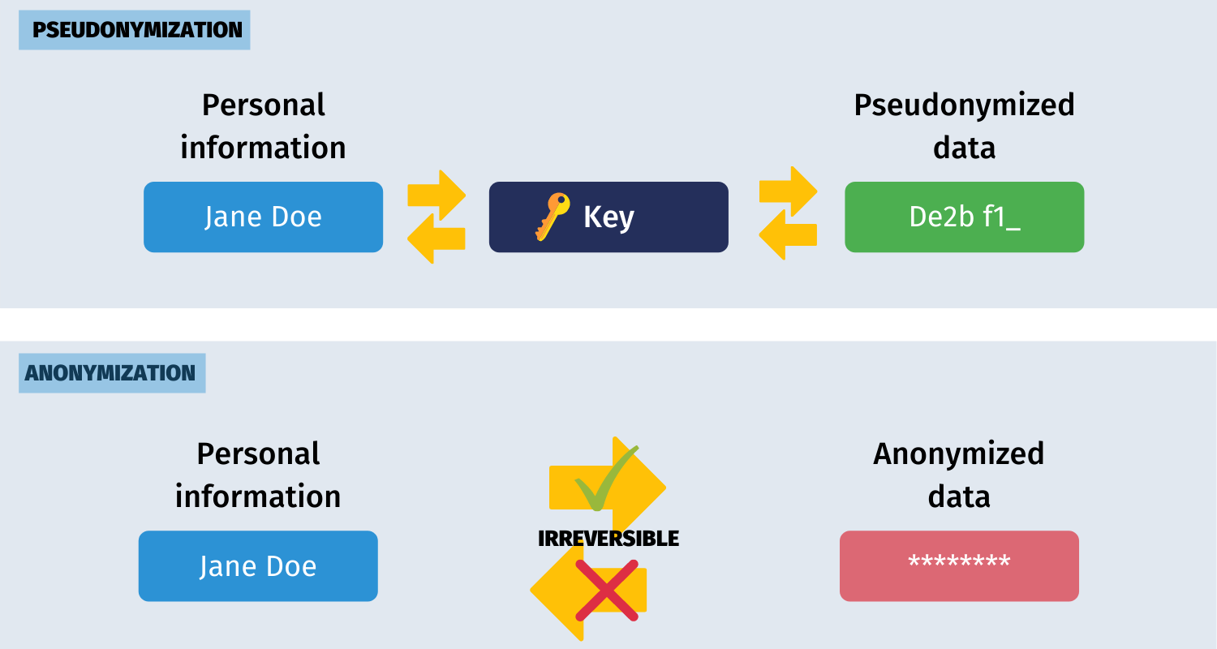
Anonymization of Personal Data
Anonymization involves removing personally identifiable information from data, making it impossible to trace back to an individual.
Anonymized data cannot be re-identified, ensuring privacy protection.
This is often used in research or when sharing data publicly for analysis.

Slide 7
Pseudonymization of Personal Data
Pseudonymization replaces identifiable data elements (e.g., names or addresses) with artificial identifiers or pseudonyms, allowing the data to be processed without directly identifying individuals.
Unlike anonymization, pseudonymized data can potentially be re-identified if the pseudonymization key is available.

Slide 8

Secure Multi-Party Computation (SMPC)
What it is: A cryptographic technique that allows multiple parties to jointly compute a function over their inputs while keeping those inputs private. How it works: Data is split into shares and distributed among parties. Computations are performed on the shares without revealing the actual data. The final result is reconstructed without exposing individual inputs. Why it’s important: Enables collaboration on sensitive data without sharing raw data (e.g., financial institutions analyzing fraud patterns). Enhances privacy in distributed systems.

Slide 9

Homomorphic Encryption
What it is: A form of encryption that allows computations to be performed on encrypted data without decrypting it first.
How it works:
Data remains encrypted during processing.
The result of the computation is also encrypted and can only be decrypted by the authorized party.
Why it’s important:
Enables secure outsourcing of data processing (e.g., cloud computing).
Protects sensitive data during analysis (e.g., healthcare data).

Slide 10

Building Privacy and Security into AI Systems from the Start
AI systems often process sensitive data, making it crucial to embed privacy and security measures from the early design phase.
Key principles include:
Data Minimization: Collect only the data necessary for the task.
Differential Privacy: Introduce controlled noise into datasets to protect individual privacy.
Federated Learning: Train models on decentralized data to prevent unnecessary data sharing.
Explainability & Transparency: Ensure AI decisions are interpretable and bias-free.
Secure Data Handling: Encrypt sensitive data and apply strict access controls.

Slide 11
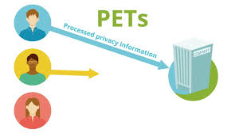
Privacy-Enhancing Technologies (PETs)
Privacy-enhancing technologies (PETs) help protect user data and minimize privacy risks while allowing organizations to derive insights from data. Examples include:
Homomorphic Encryption: Enables computations on encrypted data without decrypting it.
Secure Multi-party Computation (SMPC): Allows multiple parties to compute on combined data without revealing their inputs
Differential Privacy: Adds noise to datasets to prevent re-identification of individuals.
Zero-Knowledge Proofs (ZKPs): Allow verification of data without revealing the actual data.
Synthetic Data: Generates artificial datasets with similar statistical properties to real data, ensuring privacy.

Slide 12

Implementing Secure Software Development Practices
Secure software development ensures that applications and AI models are resistant to security threats from the ground up. Best practices include:
Secure Coding: Follow secure coding guidelines (e.g., OWASP Top 10) to prevent vulnerabilities like SQL injection and cross-site scripting (XSS).
Regular Security Testing:
Static Application Security Testing (SAST): Identifies vulnerabilities in source code.
Dynamic Application Security Testing (DAST): Tests running applications for security flaws.
Penetration Testing: Simulates real-world attacks to find weaknesses.
Code Reviews and Threat Modeling: Identify potential threats early in the development cycle.
Access Control and Authentication: Use multi-factor authentication (MFA), role-based access control (RBAC), and secure APIs.

Slide 13
Summary Table
Technology | Purpose | Key Benefit
Encryption | Protects data at rest and in transit. | Ensures confidentiality and integrity of data.
Anonymization | Removes PII to prevent re-identification. | Reduces privacy risks and ensures compliance.
Pseudonymization | Replaces PII with pseudonyms for reversible identification. | Balances data utility and privacy.
Secure Multi-Party Computation | Enables joint computations without sharing raw data. | Facilitates collaboration while preserving privacy.
Homomorphic Encryption | Allows computations on encrypted data. | Enables secure data processing in untrusted environments.

Slide 14

















الشراكات العالمية

Slide 15
شــــــكــــرًا لكــــــم
THANK YOU

